Slide 2

Ashish Tiwari
Senior Developer Advocate, Elastic @_ashish_tiwari | ashish.one

Slide 3

Turning mountains of data into actionable insights
Common challenges
Expectations for fast, relevant data at your fingertips
Evolving technology and tool proliferation
Disparate systems
Cloud security and regulatory compliance requirements
Notes:
Enterprise organizations in all industries are facing rapidly changing market conditions — new customer trends and expectations, evolving technologies, and emerging competitor capabilities. To stay resilient, responsive, and relevant, these businesses are turning to the cloud to increase capabilities, agility, and scale on demand.

Slide 4





Elastic at a glance
NYSE: ESTC
Founded in 2012
17,900+
subscriptions
2600+
employees
54%
of Fortune 500 companies trust Elastic
40+
countries with employees

Slide 5

Elastic’s DNA is free and open
Since day one, our community and customers supporting us
We contribute to open source projects
We believe that community is more than developing code

Slide 6



Elastic on Azure makes it easier
Shorten the path to relevant data so you can visualize results and take action
Elastic Enterprise Search
Elastic Observability
Elastic Security
Create fast, relevant, secure search experiences for your website, Azure-built apps, and workplaces.
Monitor and maintain the health of the Azure infrastructure that powers your digital business. Get unified visibility across your ecosystem.
Prevent, detect, and respond to threats in your Azure environment. Take on use cases such as SIEM, endpoint security, threat hunting, cloud native security and more.

Slide 7

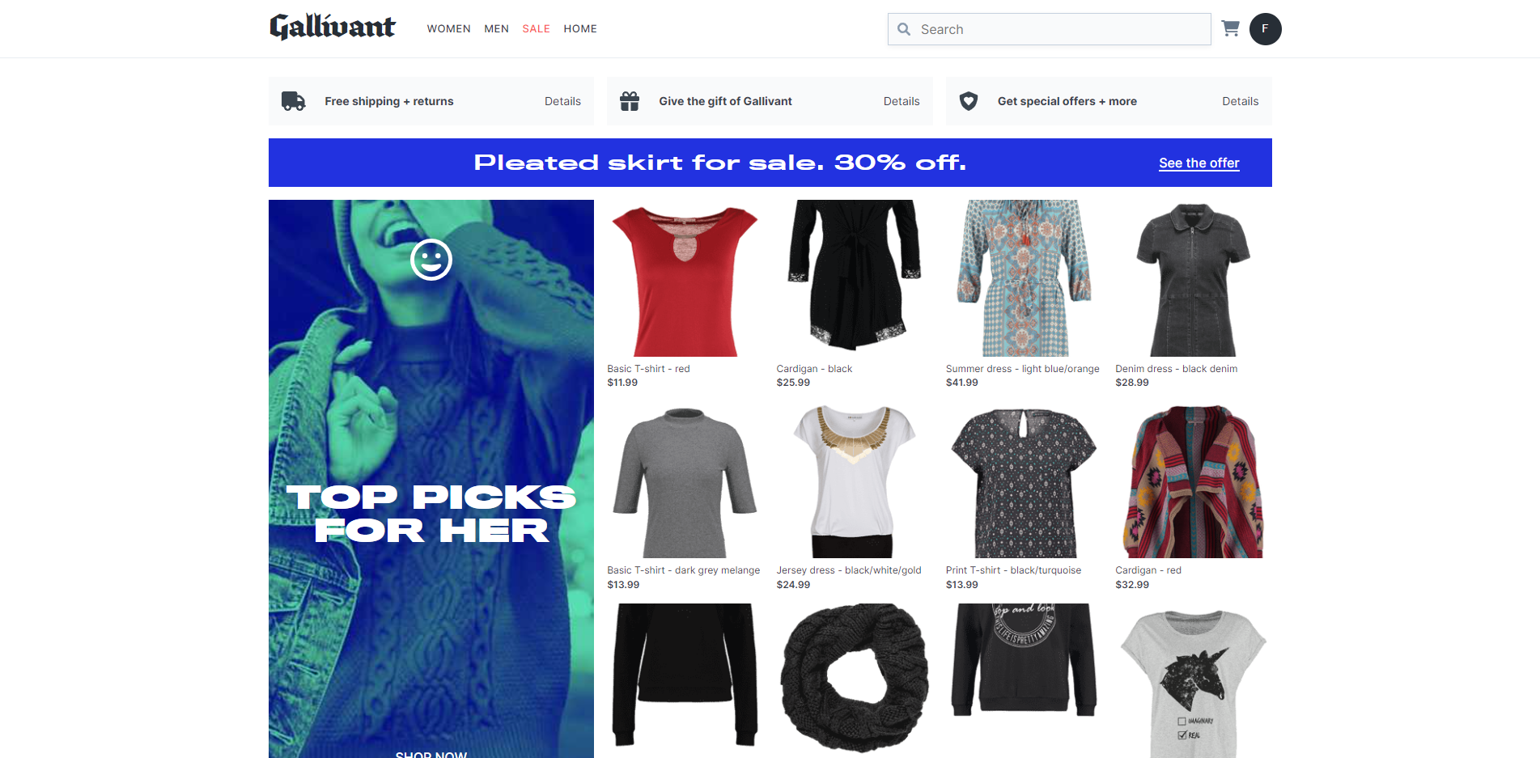
Imagine you are responsible
for an application like this …

Slide 8
Let your users find what they search for is one important driver for better conversion

Slide 9





BEST PLATFORM FOR
Enterprise Search
WEBSITES
Search drives improved user experiences and increased conversions
APPLICATIONS
Search enables new monetization models and app stickiness
IN THE WORKFORCE
Search increases employee productivity across internal docs and applications
Notes:
It’s the best platform for Enterprise Search.
Context:
we expect to be able to find the information we need, when we need it (i.e. in real time)
the information we’re looking for (we = ourselves, our customers, our employees) - it’s everywhere - it lives on websites, in applications, in knowledge bases, on file sharing platforms, and more
The Elastic Search Platform is able to easily and efficiently connect people and teams with content that matters.
It helps bridge the gap between the search experiences that companies are currently delivering and what customers have come to expect. It makes it possible to create enterprise-grade, modern search experiences using a fraction of the resources that would be required to build everything from scratch.
Elastic for Enterprise Search enables (our) customers to search everything, anywhere, in real-time.

Slide 10
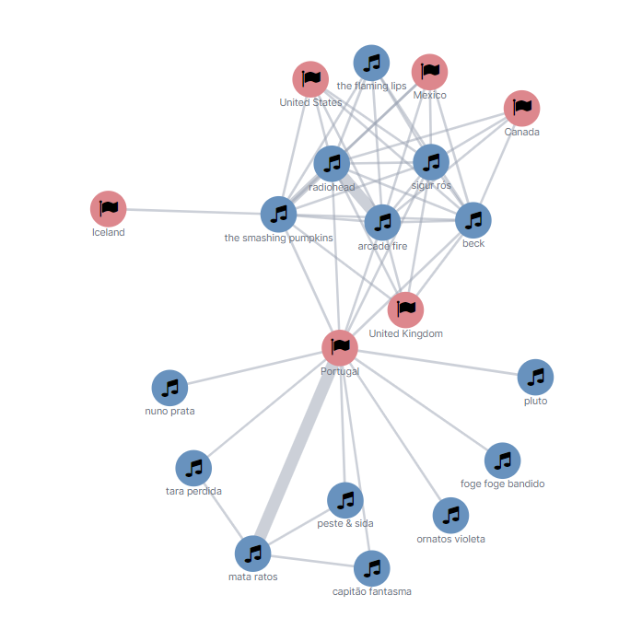
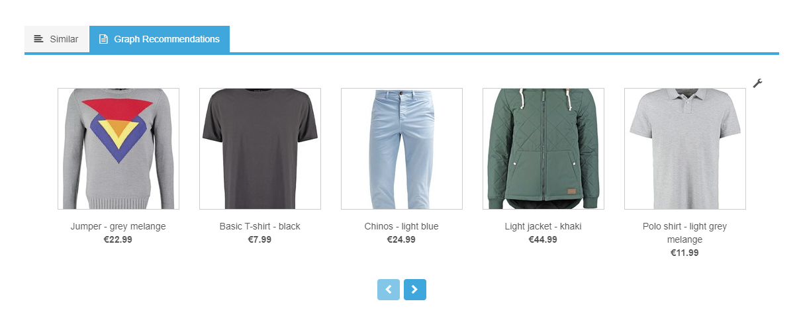
Recommendation engine
People from Germany who like black shirts also like…?
Data
Any data that can be used for recommendations, like e-commerce products, songs, videos etc and its usage
Use case
Show users of your platform what was interesting for other users
What’s possible?
Other people also bought…
Other people also searched for…
You may also like ?

Slide 11

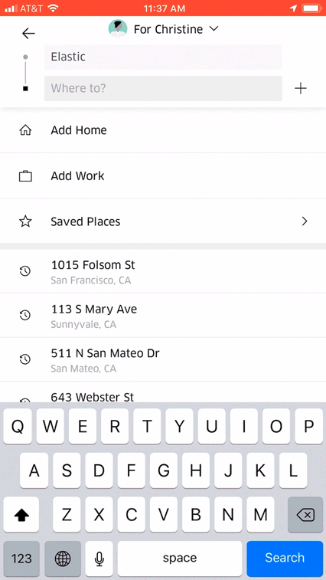
Searching for Rides
Notes:
Talking points:
When you search for a ride on Uber, Elastic is the engine that powers the Uber marketplace that connect drivers to riders.
Additional talking points about the use case:
Uber marketplace is served by data from Elasticsearch.
Massive scale - millions of users across hundreds of cities and dozens of countries.
Complex data model & query (location, time, products (pool, uberx, freight, etc), numeric, etc)
Speed of retrieval is critical -- marketplace algorithms (dispatch, pricing, forecasting, etc) rely on data from ES
Additional use cases at Uber:
Uber also powers the log analysis and on call dashboard using Elastic.
Additional Reading:
https://www.elastic.co/elasticon/conf/2017/sf/powering-uber-marketplace-real-time-data-needs-with-elasticsearch
http://eng.uber.com/elk/
Quote: ELK was an easy choice for us because it offers full-text search, geospatial query, schema flexibility, and an easy-to-assemble data pipeline. ELK can load data in near real time by ingesting Kafka topics.) ELK provided the flexibility necessary to meet our engineering guidelines and deliver an accurate, quick prediction system for our riders. Source: http://eng.uber.com/elk/
Quote: High availability, low latency, scalability, and operations friendliness is crucial to the success of our prediction system … After setting these guidelines, we laid out the blueprints for algorithms that could meet these benchmarks, assessing both online and offline designs. Source: http://eng.uber.com/elk/

Slide 12
Demo

Slide 14
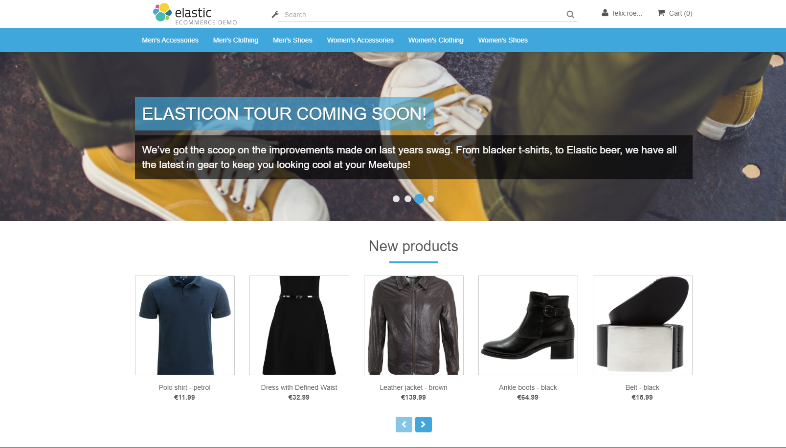

Sometimes the web application looks like this … ?

Slide 15
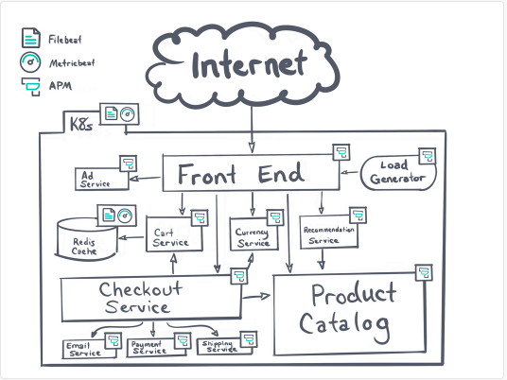

Complex architectures makes it hard to find the root cause

Slide 16
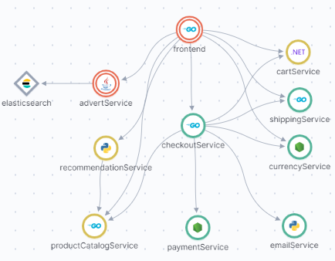
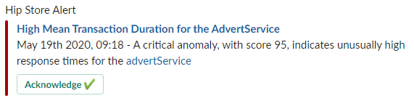
Elastic makes it easy
Caution

Slide 17





BEST PLATFORM FOR
Observability
Elastic enables correlation of logs, metrics, and application traces (APM)
Elastic improves IT operations efficiency and reduces mean time to resolution (MTTR)
Elastic provides actionable insights to meet business objectives
Notes:
It’s (also) the best platform for Observability.
Context:
thanks to an accelerating pace of technological change, enterprise IT (applications, infrastructure, etc.) is becoming more complex.
developers, admins, and architects require tools to help them keep these increasingly complex digital ecosystems both available and performant
given increasing customer and employee expectations, downtime and poor performance can be costly
The Elastic Search Platform can help businesses monitor and react to events happening anywhere.
It helps organizations to co-locate all of their logs, metrics, and traces to live in a single powerful datastore — eliminating data silos and unifying exploration and analysis for smarter detection and faster resolution.
Elastic for Observability enables customers to unify observability for their entire digital ecosystem.

Slide 18
Demo

Slide 19
Why many has chosen Elastic Cloud on Azure
Logs and metrics available in one integrated UI
Lightweight data shippers
OOTB support for almost all M&M technologies
Powerful filters on shipping AND ingest
Fine grained roles and rights mgmt
Competitive pricing
Inbuild and OOTB Machine learning

Slide 21


If you would like to prevent your page from looking like this...

Slide 22


Elastic
Security for Cloud
Security Analytics
Cloud
Cloud risk & posture management
Ensuring the environment is secured to defined standards
Audit and benchmarking
Config risks – KSPM
CSPM
Vulnerability management
IaC security
Workload monitoring and threat protection
Protecting against attacks and non-standard execution
Monitoring and alerting
Cloud EDR
Preventive controls
Unified Workflows
Deployment-time
Periodic
Continuous Runtime
Notes:
Talking point: Use slide to conclude and talk about launch plans

Slide 23


Elastic Security
Collect
Detect, Analyze, Investigate
Respond
Data Sources
P/I/SaaS
User
Network Activity
Endpoint
Server
Wire & Flow Data
Code Repository
Connected Devices & Physical Security
Response
Elastic Agent
SOAR
SIRP
ITSM
Custom
NORMALIZATION
Reporting
Lens + Canvas
Collection and Prevention
Elastic Agent
Built on Fast, Scalable Search
Bring your search to the data, no matter where it is
The Foundation of Modern Security, Observability, and more
Designed for tomorrow’s hybrid environments
Notes:
Elastic Security delivers that endpoint-driven approach to security operations that we’re talking about. For years, advanced security teams have deployed Elastic for any and all security use cases -- from SIEM, threat hunting, continuous monitoring, threat detection and prevention, incident response, endpoint security, and more.
And those modern security teams consider Elastic Security to be the foundation of their security operations practice -- these are teams that are living and breathing the value of Elastic Security, which again brings endpoint control directly to the SOC. These teams have been operationalizing any and all security use cases at scale and they’ve been reporting the ability to evolve faster to adapt to today’s most pressing issues, while feeling better prepared to tackle tomorrow’s unknown requirements.

Slide 24
Demo

Slide 25
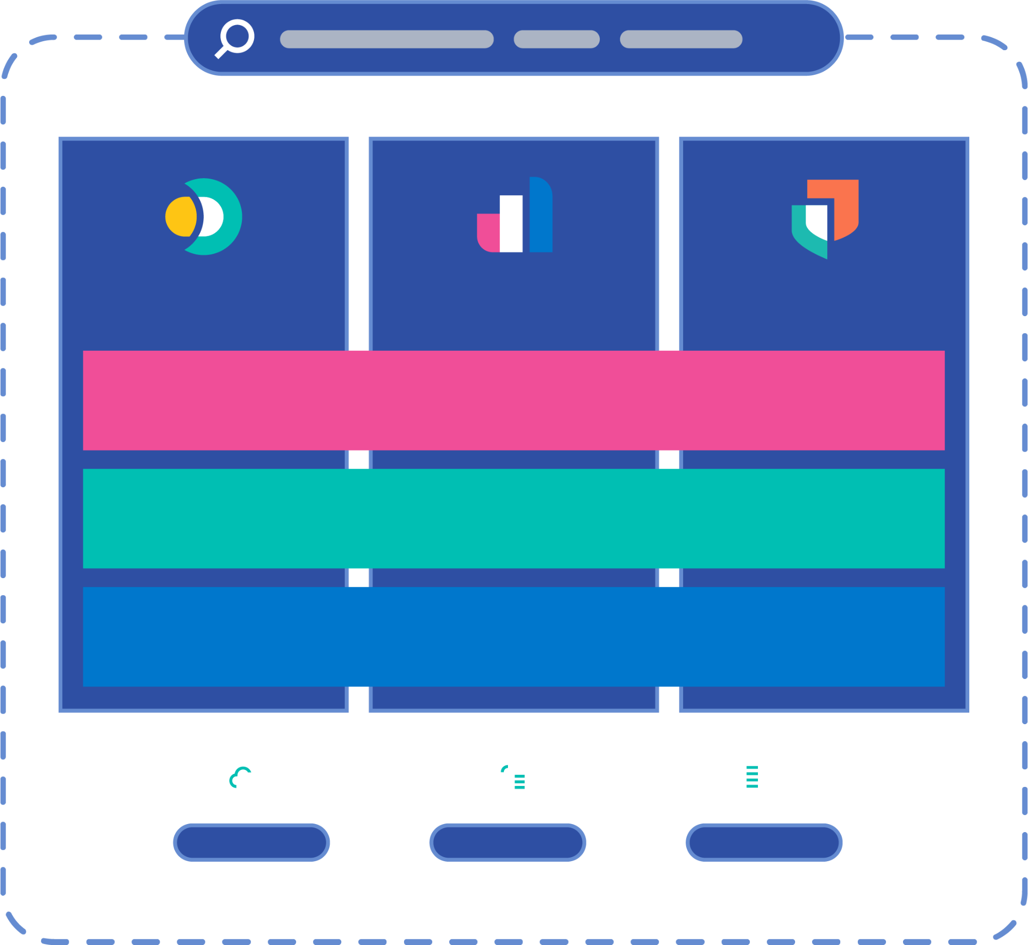

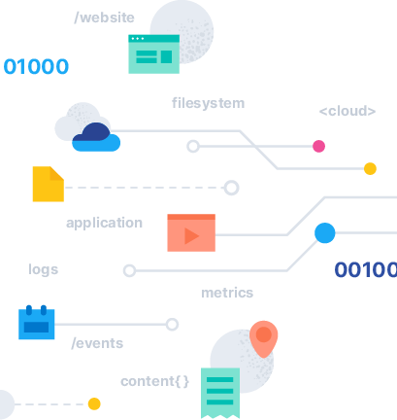
The Elastic Platform
Enterprise Search
Observability
Security
Kibana
Explore, Visualize, Engage
Elasticsearch
Store, Search, Analyze
Integrations
Connect, Collect, Alert
Public cloud
Hybrid
On-premises
Notes:
…with the Elastic Search Platform you can transform data into actionable insights, in real time

Slide 26
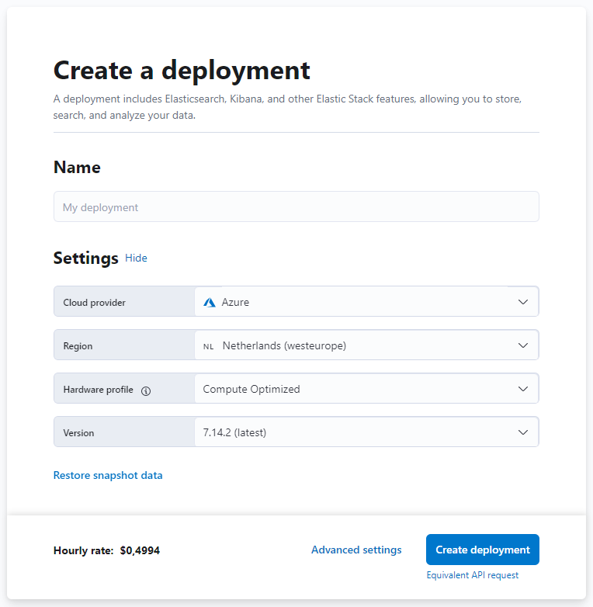


Elastic Solutions for Azure
Search, Observe, Protect
Deep dive into Search
https://ela.st/deep-dive-search
Deep dive into this solution
https://ela.st/deep-dive-observability
Deep dive into this solution
https://ela.st/deep-dive-security
Get up and running with
3 clicks in 3 minutes
30 days for free
ela.st/startnow

Slide 27







About our Partnership
Exclusive integrations
Seamless billing
Pay-per-use
Partners since 2017
Deployed in 16 Global Regions
Native integration delivers Elastic deployments within the Microsoft Azure portal
More than 20 integrations with Azure platform services
Offered on Azure Marketplace
Ability to draw down your Azure spend commitment
Deploy Elasticsearch (Elastic Cloud) natively on the Azure Marketplace.
Manage your Elastic subscriptions directly from the Azure Marketplace and get one consolidated bill.
Only pay for the resources you use and use your investment to draw down Azure spend commit.
Managed services
Future-ready
Best-in-class security
Leave maintenance and upkeep to Elastic to reduce operational overhead. Optimize using APIs and technology that complements your Azure tools.
Automatic upgrades, commercial features, rapid deployment and resizing.
Advanced security features and encryption meets global compliance standards.

Slide 28
How
Elastic on Azure
Benefits You
Freedom to deploy on Azure your way
Choose between a managed service or with orchestration tools to help you manage and scale. Select between our preconfigured solutions for enterprise search, observability and security, or build your own search and visualization solution on the Elastic Stack
Valuable integrations
We innovate together to provide you a frictionless user experience across management, billing, and support. Your investment in Elastic can be used to draw down your Azure spend commitment and you get one single consolidated bill
We do the heavy lifting
Leave maintenance and upkeep to us with our managed service offering, and get the authentic Elastic solutions from the people that built them. Gain access to seamless upgrades, commercial features, and built-in security
Complementary technology
Elastic supports Microsoft technology such as Azure Event Hub, Azure Monitor, Azure Active Directory, .NET developer SDKs, and much more.

Slide 29


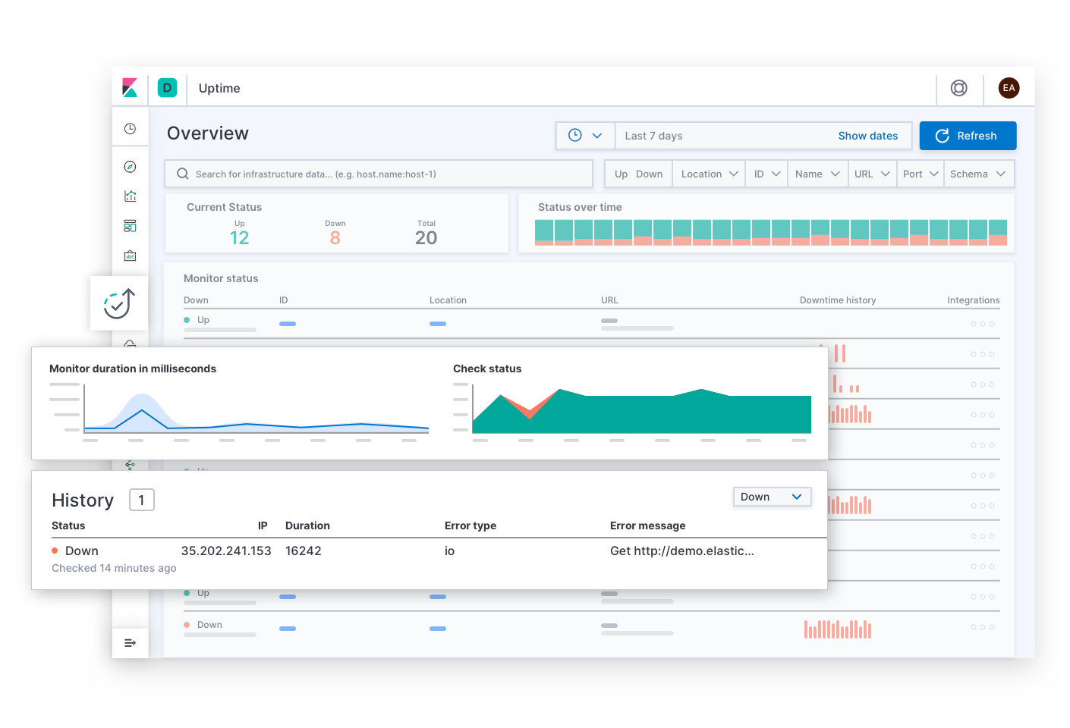







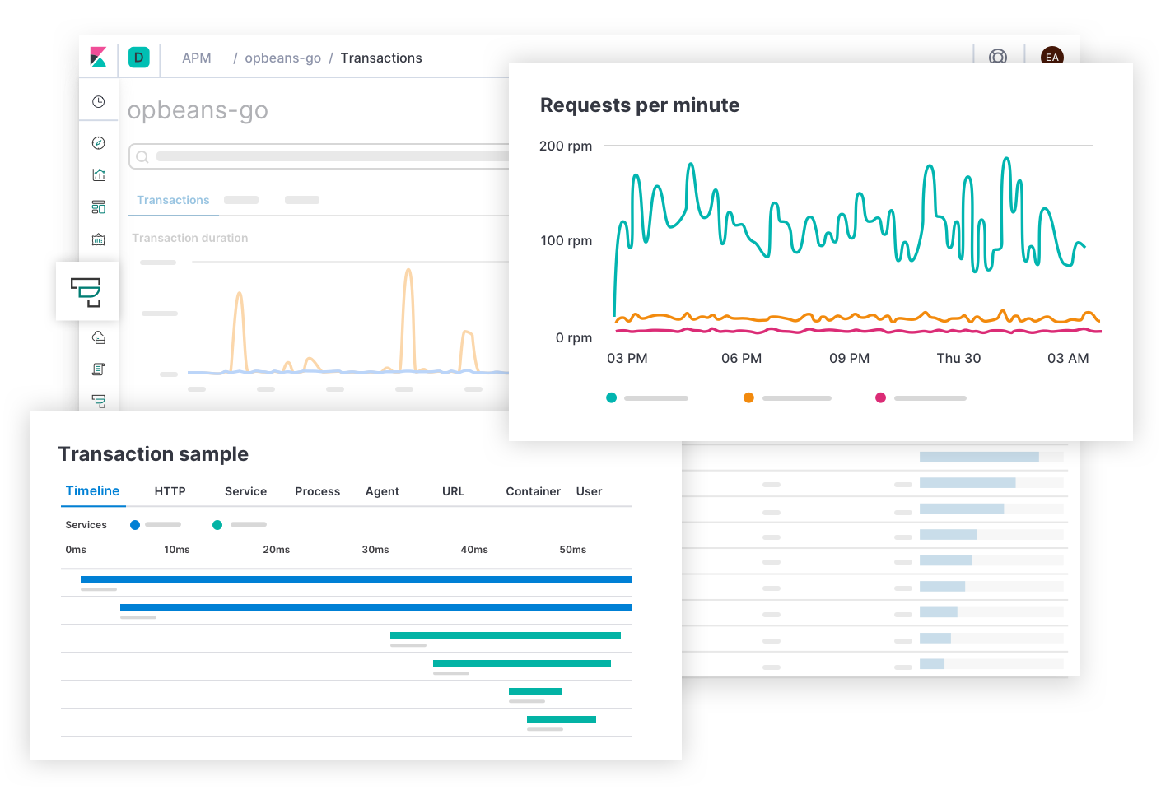










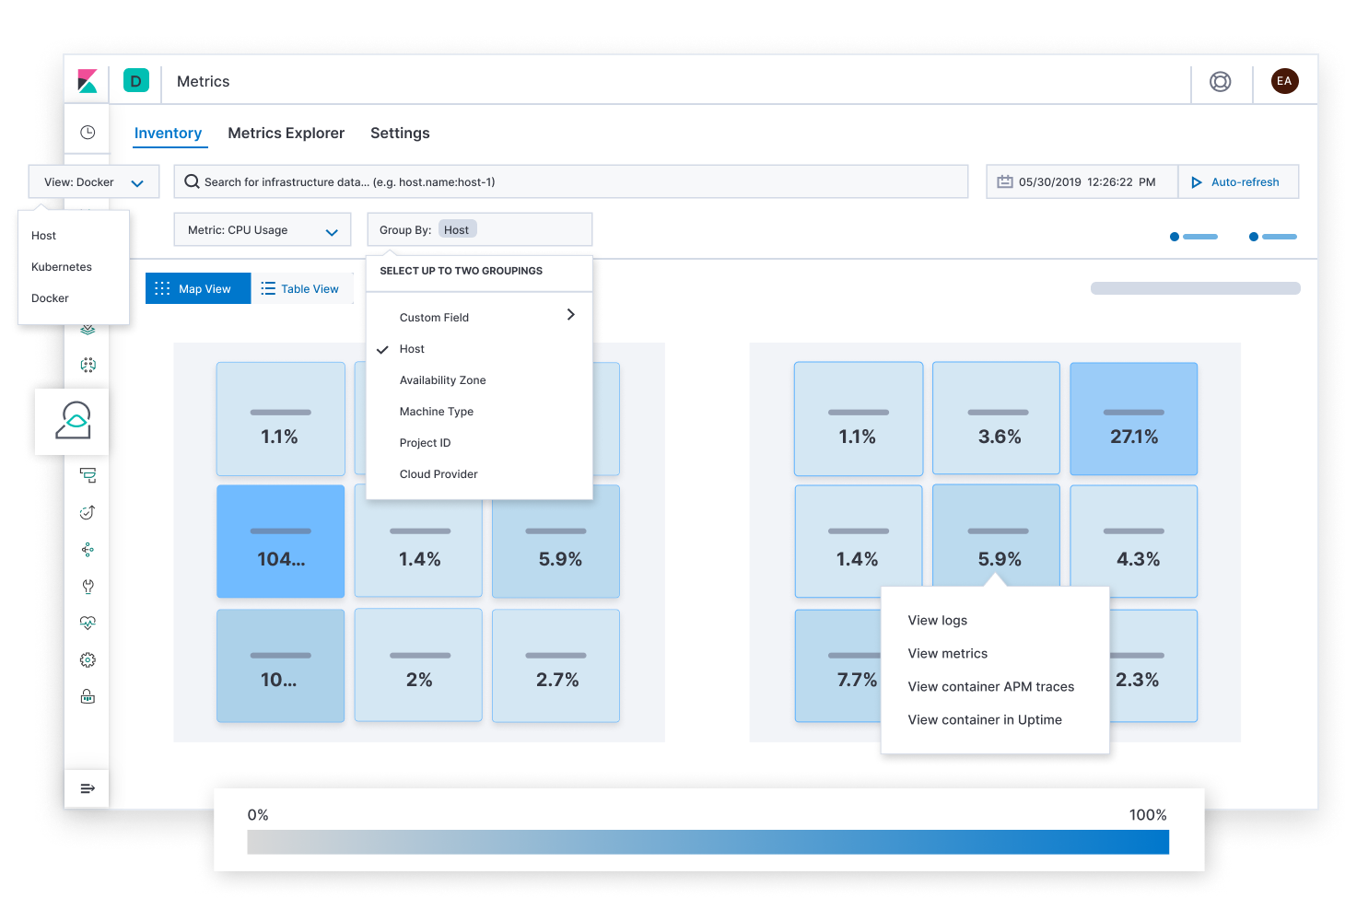











Elastic Observability on Azure
Azure Activity Logs
Azure App Insights
Azure Container Registry
Azure Functions
Azure VM Scalesets
Azure Database Account
Azure Platform Logs
Azure Private Link
Elastic Ingestion
Azure Kubernetes Service
Azure Container Instance
Azure Containers
Azure Native Integration
Azure Monitor
Azure VM
Microsoft IIS
Azure Event Hub
Azure Storage
Elastic Cloud on Azure
Managed Service
Microsoft Azure
Turn-key observability integrations

Slide 30







Deploying Elastic on Azure
Control
Productivity
Available on Azure Marketplace
Available on Azure Marketplace
Elastic Azure ARM Template
Elastic Cloud
Enterprise
Elastic Cloud
on Kubernetes
Elastic Cloud
Elastic Managed Service
In 12 Azure regions worldwide
Azure VMs
Azure VMs
Azure Kubernetes Service
Customer Azure Subscription
Azure Subscription
supports
Azure Private Link
Compute
Container
SaaS

Slide 31


Deploy where you want
The global footprint of the official managed Elasticsearch Service
10 Azure Regions
16 Azure Regions
Americas
Azure Brazil South (São Paulo State)
Azure Canada Central (Toronto)
West US 2 (Washington), azure-westus2
East US 2 (Virginia), azure-eastus2
Central US (Iowa), azure-centralus
South Central US (Texas), azure-southcentralus
East US (Virginia), azure-eastus
Europe
Azure South Africa North (Johannesburg)
West Europe (Netherlands)
UK South (London)
North Europe (Ireland)
France Central (Paris)
Asia Pacific
Azure Central India (Pune)
Southeast Asia (Singapore)
Japan East (Tokyo)
Australia East (New South Wales)
Notes:
Wherever you are, we most likely have a region available near you as we now have a worldwide footprint
This delivers faster performance and better data locality options which can be critical in the GDPR era.

Slide 32
Deployment Options on the Azure Marketplace
 | Elastic Cloud (Elasticsearch Service) | Elasticsearch (Self-managed on Azure VMs)
Powerful search and visualization | ✓ | ✓
Solutions for observability, enterprise search, and security | ✓ | ✓
Reduced operational complexity for more time to develop, innovate, and analyze | ✓
Manual options for cluster management (e.g. additional regions, instance types, VNet connectivity) |  | ✓
Cluster maintenance by the creators of Elasticsearch | ✓
Real-time updates on Elastic versions | ✓
Security best practices enabled by default | ✓
Eligible for Azure spend commitment | ✓
Average number of configuration steps | 10 | 100
Minimum requirement for deployments | 3 days | 3 weeks

Slide 33

Getting started on Azure

Slide 34



Why leading organizations choose Elastic
Results oriented
Out of the box or tailor made, we help you drive the right results.
Scale at your speed
Building for new use cases? Migrating to the cloud? Scaling with Elastic is easy.
Our community is your advantage
App developers, security leaders, data scientists, business executives — we foster an ecosystem of creators.
Notes:
Come back to open source

Slide 35

Thank you
Ashish Tiwari | @_ashish_tiwari

